Slide 1
History of Portugal “A short summary”
Spectra-Physics International Sales Meeting,
Estoril, Portugal
Edited by
Paulo Macedo
May 9, 2014

Slide 2
A long time ago in a land close,
close by.…

Slide 3
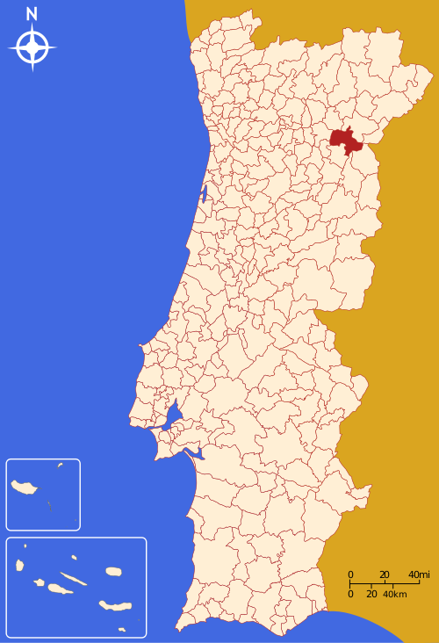
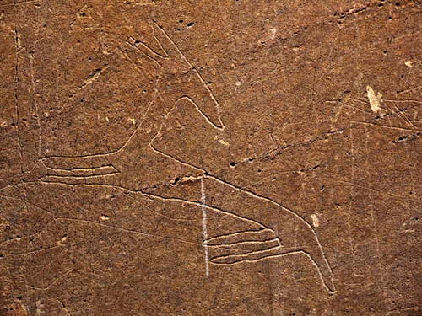
Long before Portugal…
The rock engravings in Foz Côa and Siega Verde, dating from the Upper Paleolithic to the final Magdalenian/ Epipaleolithic (22.000 – 8.000 BCE), represent a unique example of the first manifestations of human symbolic creation and constitute an unrivalled source for understanding Paleolithic art. (UNESCO World Heritage website)

Slide 4
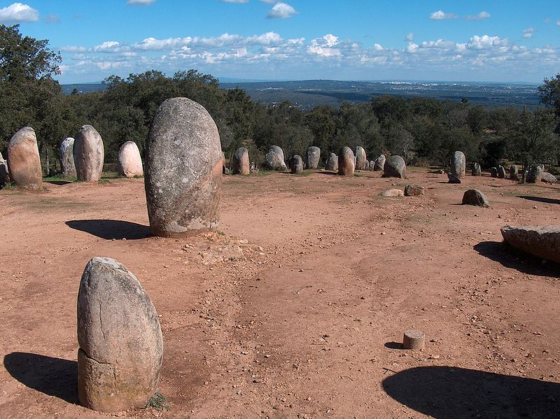
Megalithic Architecture
Cromlech of the Almendres, near Évora
(ca. 6000 BC)

Slide 5
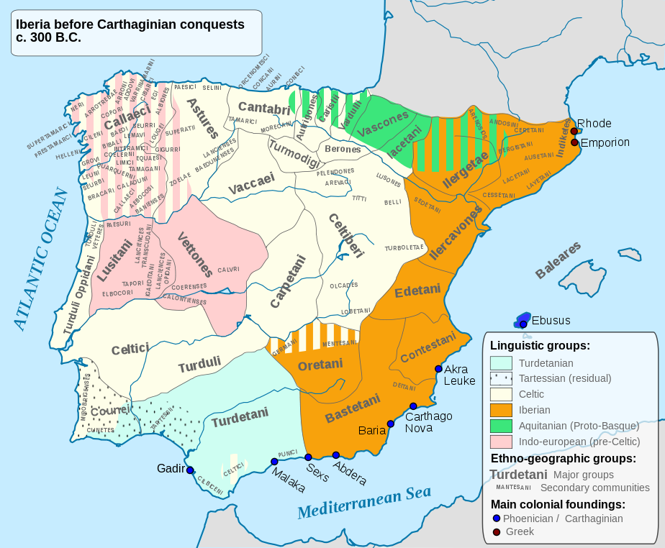
Pre-Roman peoples in Iberian Peninsula
Celts and Proto-Celts
Iberians
Aquitanians
(main groups)

Slide 6
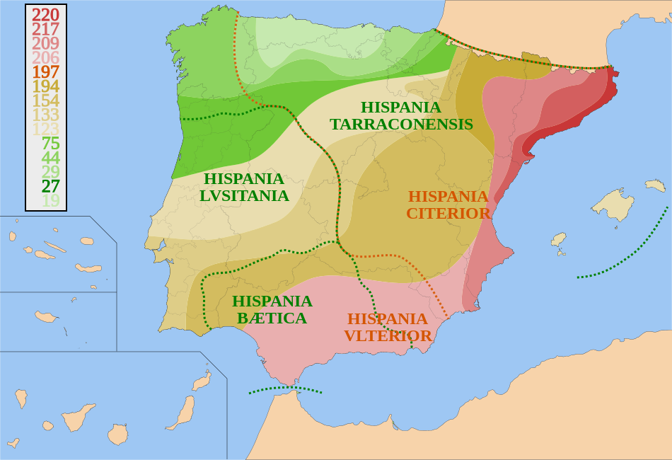
Roman invasion of Iberia (Hispania)
Started in 219 BC (Second Punic War), final conquest/anexation in 19 BC (Cantabrian Wars)

Slide 7
Lusitanian War, or War of Fire (155 BC – 139 BC)
First clash between Rome and Lusitanian people in 194 BC, leading to a peace treaty in 179 BC
In 155 BC, Lusitanians, led by Punicus, raided Roman territories, leading to a Roman reaction
In 150 BC, Roman commander Servius Sepulcius Galba orders the massacre of thousands of Lusitanians, after pretending to accept a truce

Slide 8
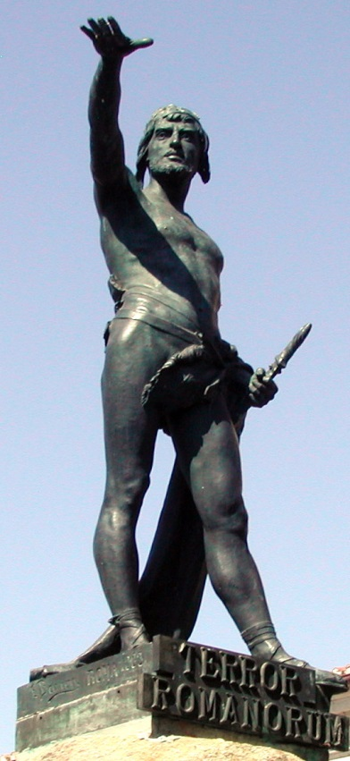
Viriathus, leader of the Lusitanians
Having survived the massacre, Viriatus joins the rebellion, and in 147 BC he’s among a large group under Roman siege
When his comrades consider surrendering to Rome, Viriatus reminds them of previous Roman treachery and convinces them to follow him and escape the siege.
“Excited by the new hopes with which he inspired them, they chose him as their leader. (…) Thus did Viriathus, in an unexpected way, rescue his army from a desperate situation. This feat, coming to the knowledge of the various tribes of that vicinity, brought him fame and many reinforcements from different quarters, and enabled him to wage war against the Romans for eight years.” (Appian, History of Rome)
Statue of Viriatus, in Zamora, Spain

Slide 9
Death of Viriathus
After years of war, both conventional and guerilla war, Viriathus spared Servilianus and his soldiers from near-certain defeat/death, and proposed an agreement, later ratified by Rome (141 BC).
“Viriathus was declared to be a friend of the Roman people, and it was decreed that all of his followers should have the land which they then occupied. Thus the Viriathic war, which had been so extremely tedious to the Romans, seemed to have been settled satisfactorily and brought to an end.” (Appian, History of Rome)
One year later, Romans break the treaty and open hostilities against Viriathus; in 139 BC, Viriathus sent 3 emissaries to negotiate terms of peace, who were bribed by Romans to assassinate Viriathus.
After their return, the 3 traitors killed Viriathus in his sleep.

Slide 10
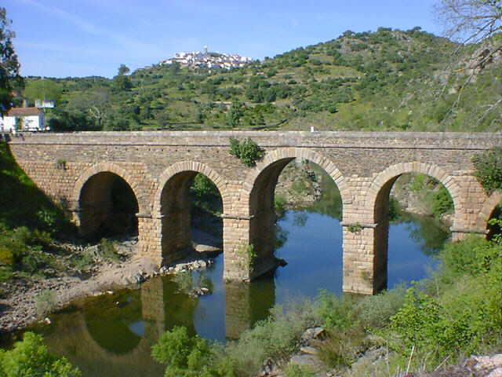
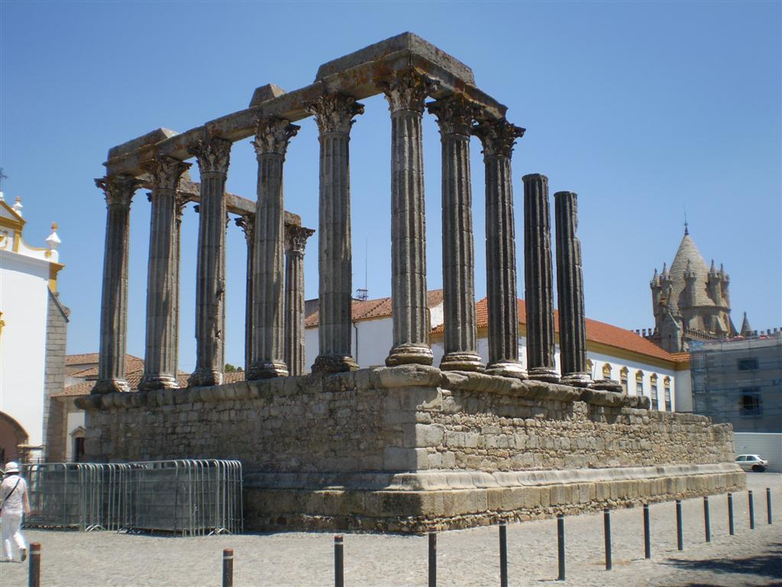
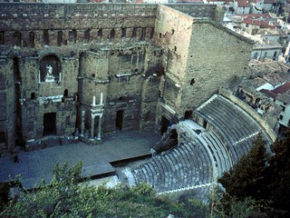
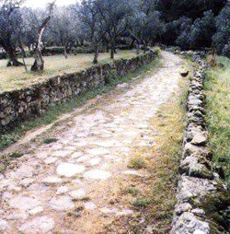
Under the Roman rule of Hispania, not all was war, death and destruction…

Slide 11
Quiz time
- Guess which people identifies itself with the following definition:
“There is, in the westernmost part of Iberia, a very strange people: they do not govern themselves nor do they allow themselves to be governed”
This somewhat legendary phrase (or variations thereof) has been credited to at least 2 Roman leaders, Servius Galba and Caius Julius Caesar, the “strange people” being, of course, the Lusitanians (Portuguese)

Slide 12
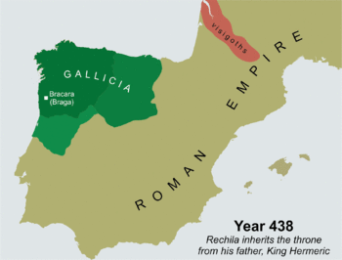
Germanic Barbarians
Kingdom of the Suevi, or Kingdom of Gallaecia, established around 410 AD
Conquered, and
annexed, by the
Visigoths in 485 AD
(animated GIF)

Slide 13
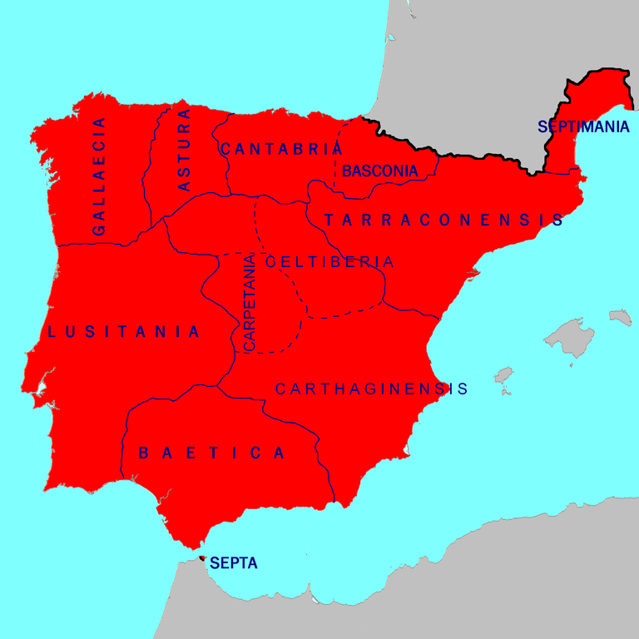
Germanic Barbarians II
585-711 Visigothic Kingdom of Hispania
Visigoths, siding with
Rome at first, and later
against Rome, eventually
defeated the Sueves
and conquered the
entire peninsula

Slide 14
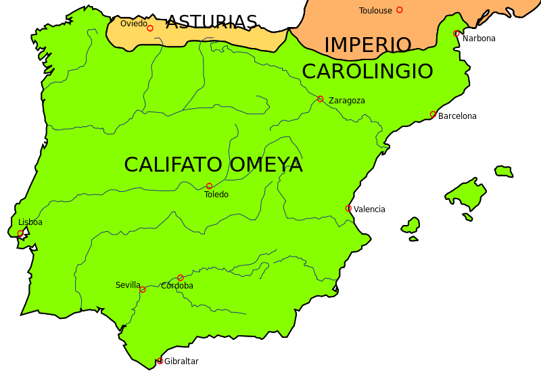
Moors / Islamic Conquest, 711-868
The Moors (Islamic Berbers and Arabs) enter the Peninsula in 711 and conquer it almost entirely by the year of 718 (map in 720 AD)
Pelayo (or Pelagius), a
Christian Visigothic king,
resists in Asturias,
defeating the Moors at
the Battle of Covadonga
(722 AD)

Slide 15
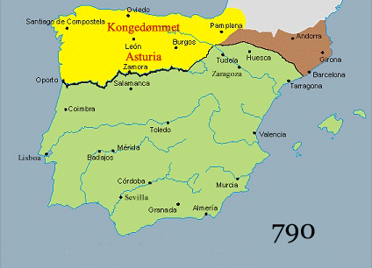
Reconquista, 722-1492
(animated GIF)
Starting as a territorial fight for land, evolved to a religious war, under pressure and encouragement of the Church. At times, Crusaders en route to the Holy Land helped fighting the Moors in the Iberian Peninsula

Slide 16
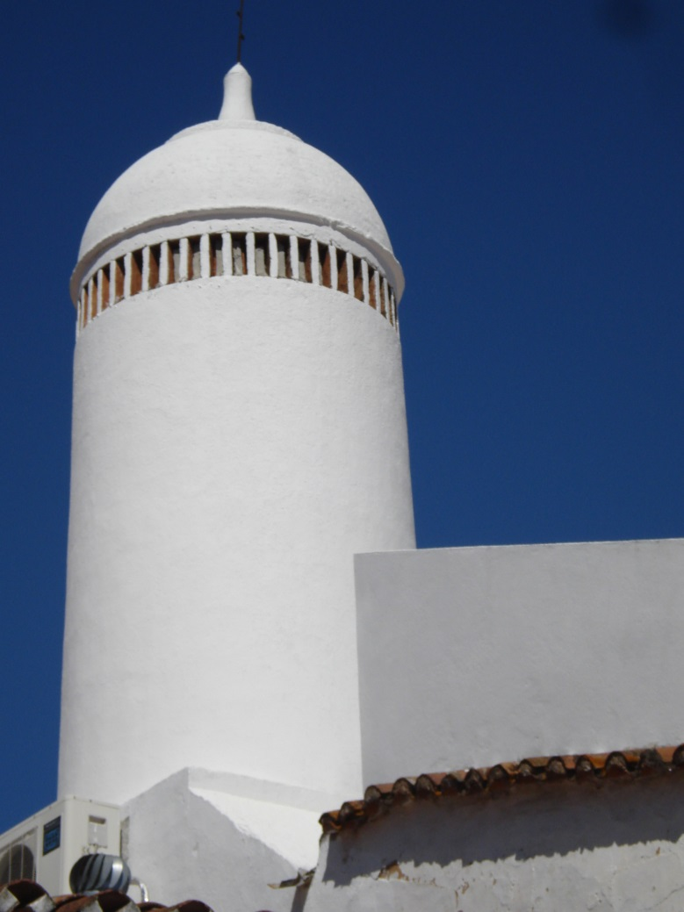
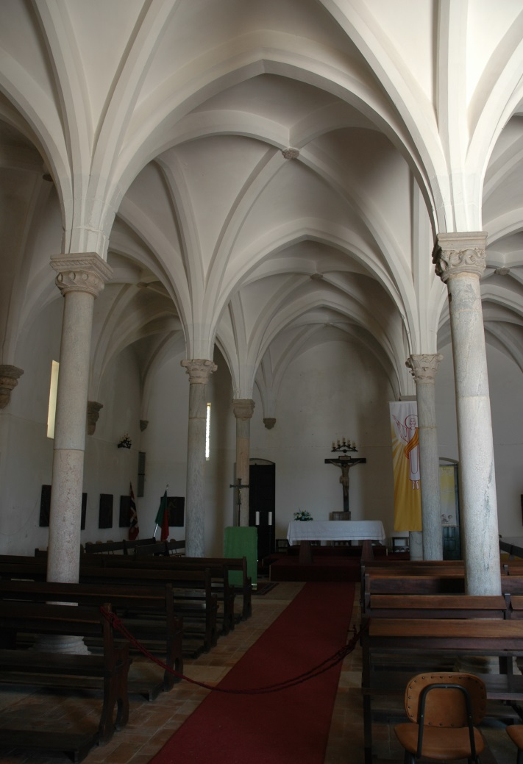
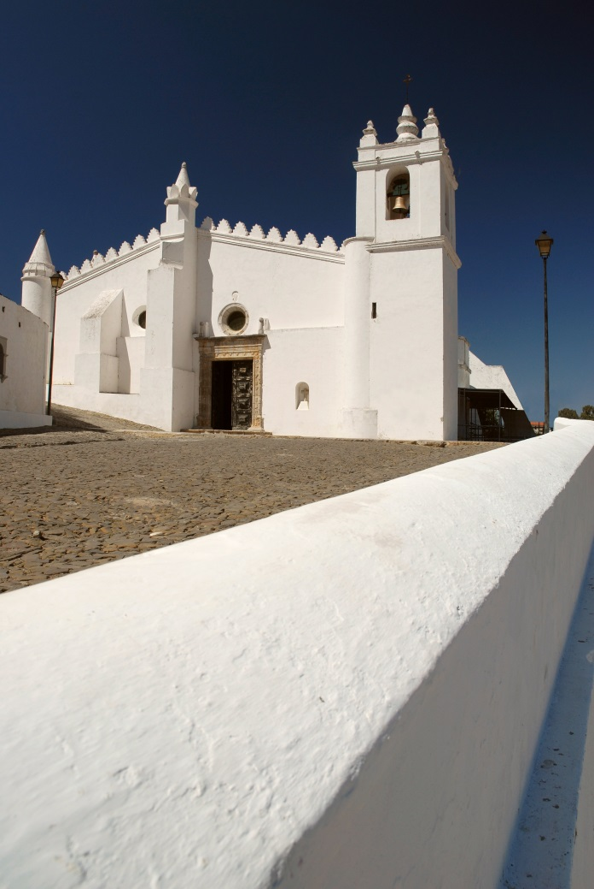
Moorish influence in Portugal

Slide 17
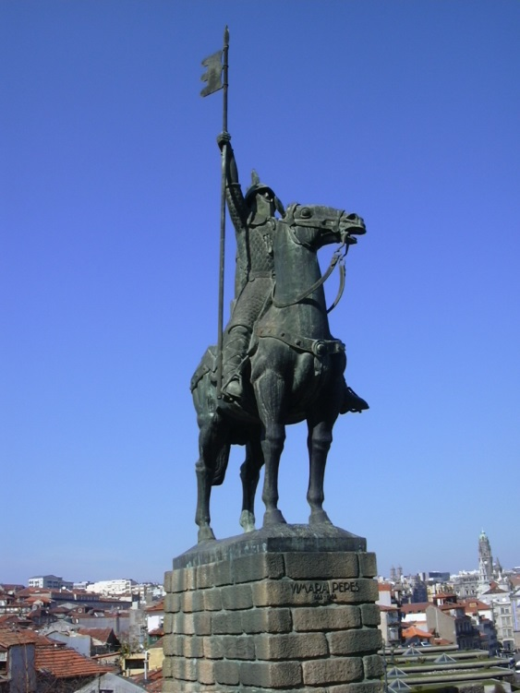
First County of Portugal, 868-1071
868 AD - Conquest of Porto (then named Portus Cale) by Vimara Peres, a noble vassal of the king of Asturias
The area between the rivers Douro and Minho becomes the first County of Portugal
938 AD - First document where the word Portugal is written in its present form, evolving from Portucale
The independent County was abolished in 1071, after Count Nuno Mendes (last of the Vimara Peres house) is defeated in the battle of Pedroso, and the Kingdom of Galicia and Portugal is integrated in the Kingdom of Castille and Léon by Alfonso VI

Slide 18
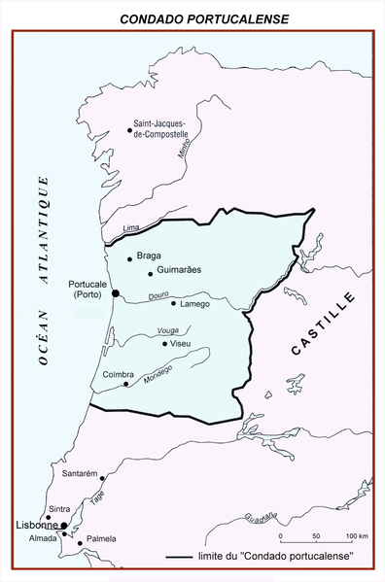
Second County of Portugal (Condado Portucalense)
1096 – Alfonso VI grants the newly formed County of Portugal and Coimbra to his son-in-law Henry of Burgundy
1112 – Count Henry dies, and most Portuguese favour independence
1122 - Son of Henry, Afonso Henriques, aged 14, makes himself a Knight in Zamora.
1128 - Count Afonso Henriques defeats the army of his mother, Theresa, Countess of Portugal, in the battle of S. Mamede (near Guimarães) and becomes Duke of Portugal

Slide 19

D. Afonso Henriques
1129 – Afonso proclaims himself Prince of Portugal
1139 – Afonso obtains a
clear and important victory
against 5 Moor kings in the Battle
of Ourique, after which he’s
acclaimed as King of Portugal
1143 – Treaty of Zamora recognizes Portugal’s independence from the Kingdom of Leon
1179 – The Pope recognizes Afonso I as King

Slide 20
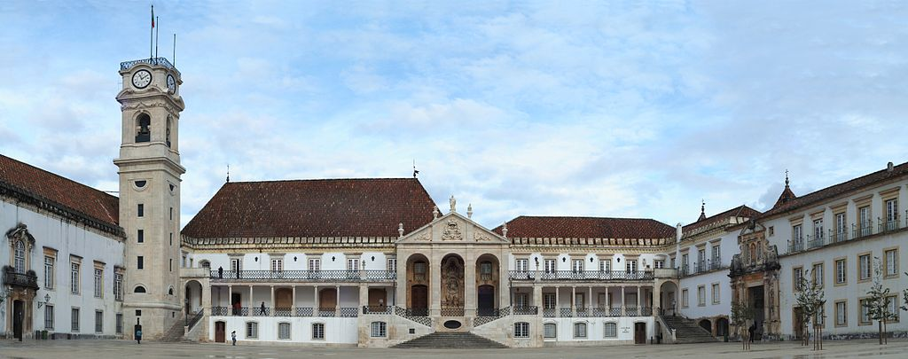
University of Coimbra
Founded in 1290, is one of the oldest Universities in the world

Slide 21
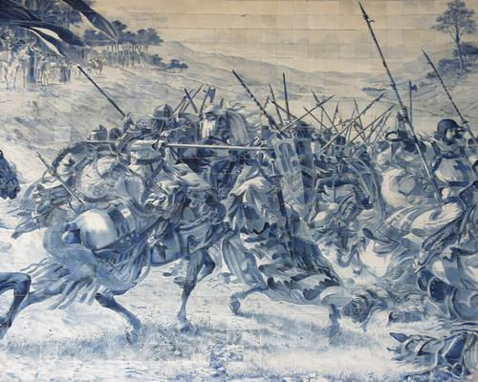
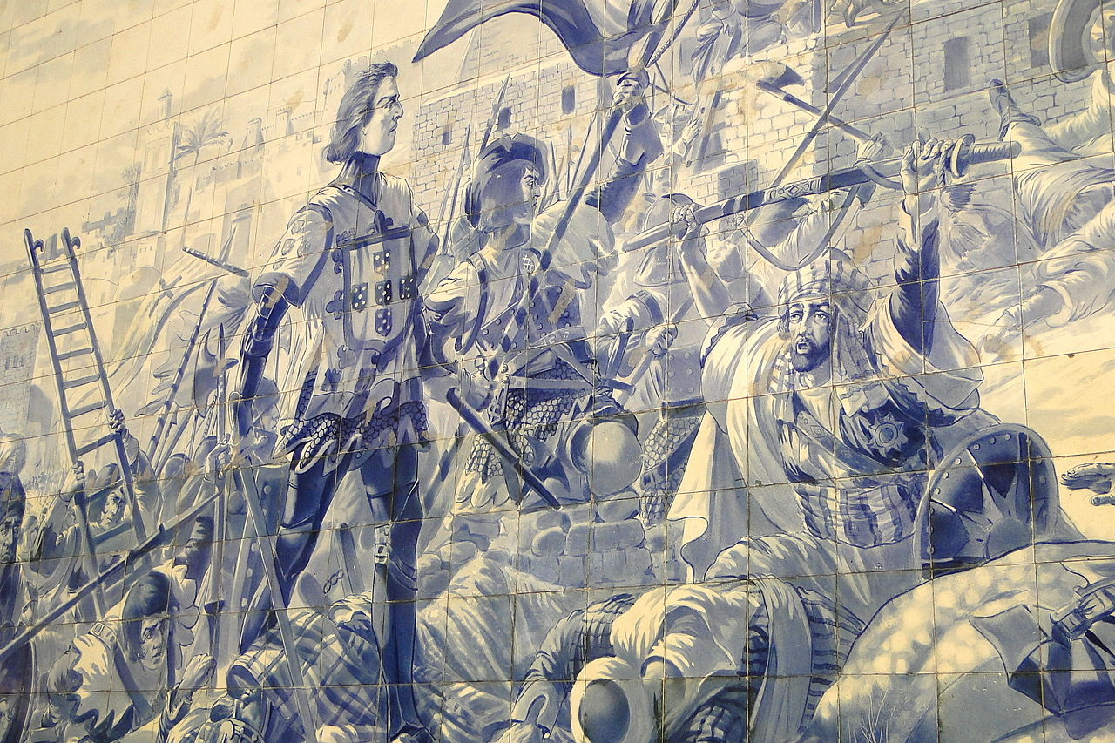
Azulejos
Introduced in Portugal by the Moors, became a very popular and important aspect of Portuguese arquitecture

Slide 22
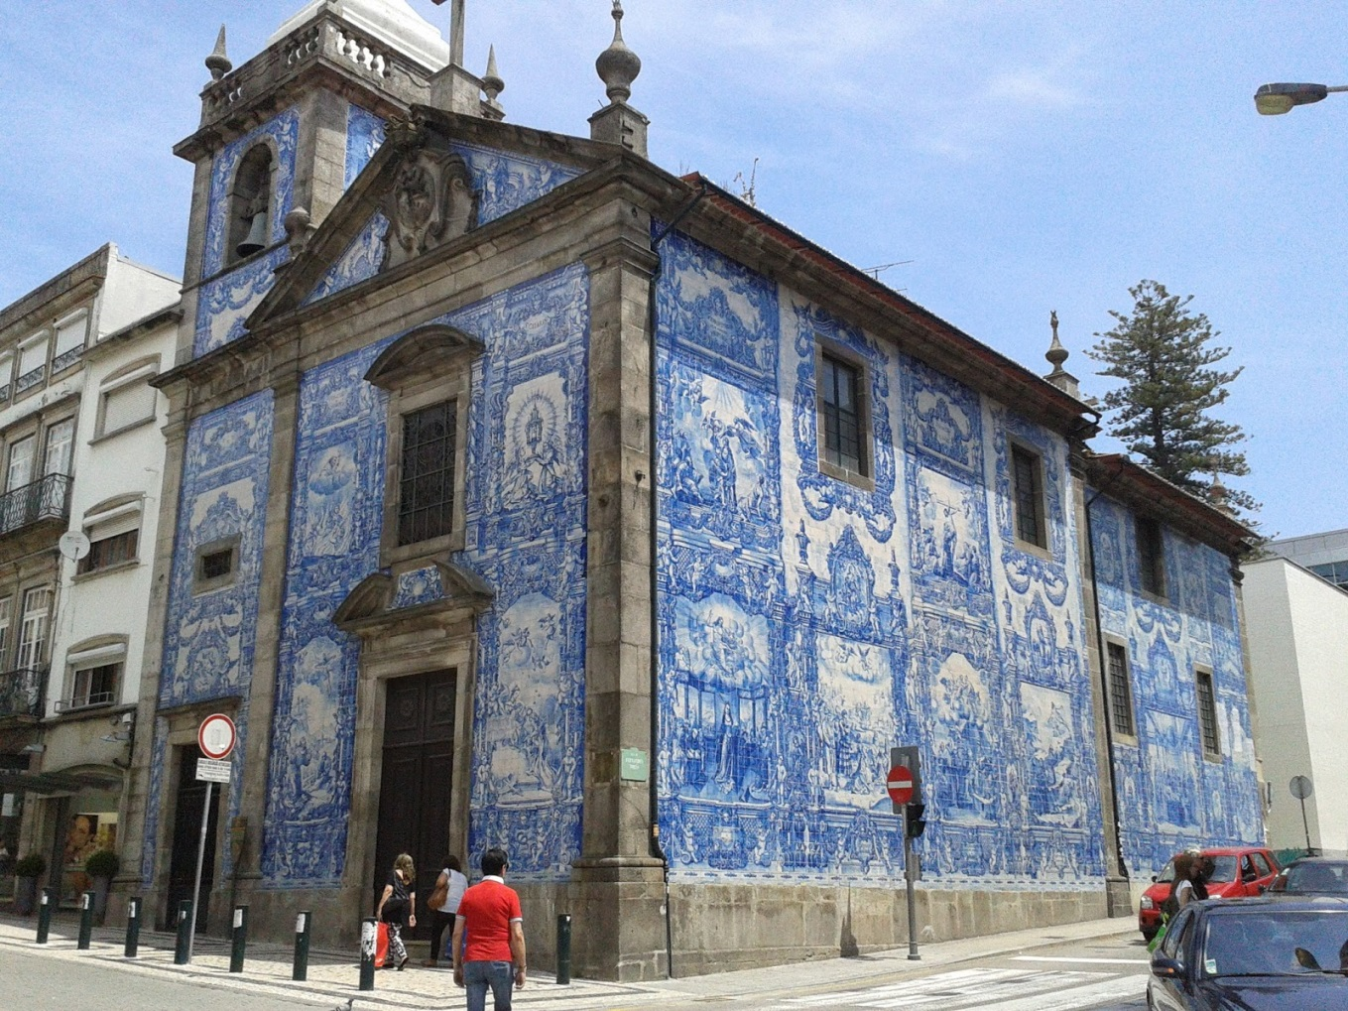
Azulejos
The Chapel of Souls, Porto

Slide 23
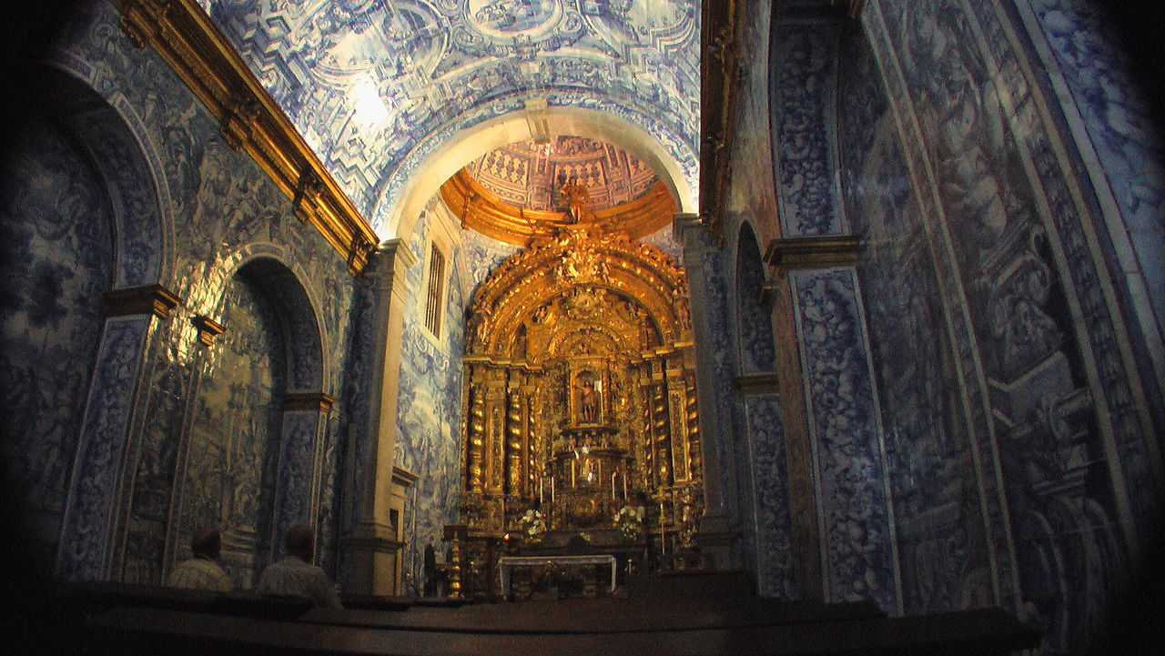
Azulejos
St. Lourenço’s Church, Almancil

Slide 24
Pedro and Inês, or “boy meets girl” in Shakespearean tones (1339-1355)
Pedro meets Inês de Castro, lady-in-waiting of his wife Constança, in 1339
Pedro and Inês maintain a love affair, under strict disapproval of the king, Afonso IV
After Constança’s death in 1345, tension grows between father and son until, in 1355, Afonso orders the assassination of Inês
Pedro revolts against his father and is defeated within one year, but Afonso dies shortly after and Pedro becomes king in 1357
Pedro takes his vengeance, after capturing 2 of the 3 assassins
Inês’ killers were executed having their hearts removed, one throuh his chest and the other through his back, while Pedro watches

Slide 25
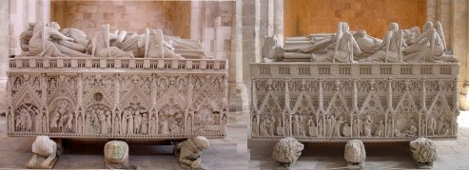
“The Dead Queen”
In 1361, Pedro has Inês’ body exhumed and reburied with royal honours in the monastery of Alcobaça.
Pedro had two “twin” tombs made, one for Inês, the other reserved for him. Richly decorated, both tombs have the inscription “Until the end of the world”
The tombs are placed facing each other, so that the first thing they’ll see when they rise at the Last Judgement (“the end of the world”) is each other

Slide 26
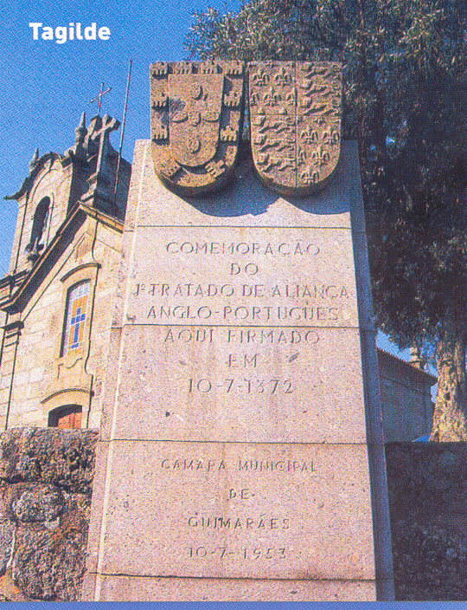
Anglo-Portuguese Treaty of Alliance and Friendship
The oldest alliance between two nations still in force today
First foundation of the alliance, the Treaty of Tagilde, signed in 1372, between Fernando I and Edward III
Treaty of alliance and “perpetual friendship” between England and Portugal, London, 1373
Treaty of Windsor, 1386

Slide 27
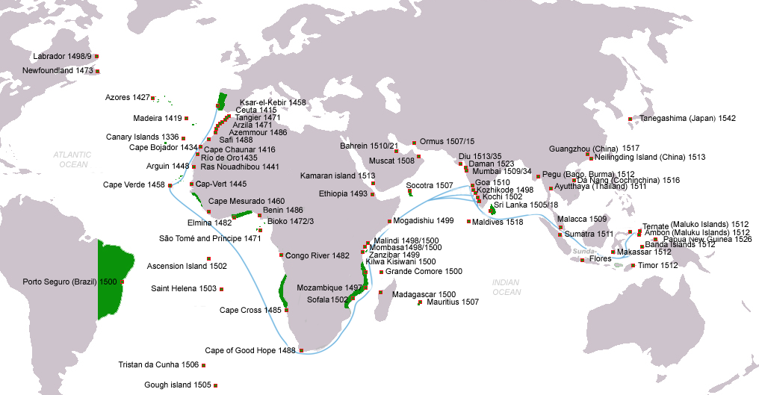
Age of Discoveries

Slide 28
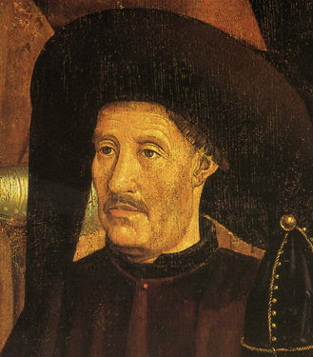
Age of Discoveries
1412—Prince Henry, the Navigator, orders the first expeditions to the African Coast and Canary Islands.
1415—Conquest of Ceuta (North Africa)
1419—João Gonçalves Zarco and Tristão Vaz Teixeira discovered Porto Santo island, in Madeira group.
1420—The same sailors and Bartolomeu Perestrelo discovered the island of Madeira
1427—Diogo de Silves discovered the Azores, which was colonized in 1431 by Gonçalo Velho Cabral.
1434—Gil Eanes sailed round Cape Bojador, thus destroying the legends of the ‘Dark Sea’.
1444—Dinis Dias reached Cape Green (Cabo Verde).
1446—Álvaro Fernandes reached the northern part of Portuguese Guinea
1458—Luis Cadamosto discovers the first Cape Verde Islands.
1460—Death of Prince Henry, the Navigator. Systematic mapping of Atlantic reached 8° N on African Coast and 40° W in the Atlantic
1471—João de Santarém and Pedro Escobar crossed the Equator. Discovery of the islands of São Tome and Principe.
1482—Diogo Cão reached the estuary of the Zaire (Congo) and placed a landmark there. Explored 150 km upriver to the Ielala Falls.
1484—Diogo Cão reached Walvis Bay, south of Namibia.
1488—Bartolomeu Dias, crowning 50 years of effort and methodical expeditions, rounds Cape of Good Hope, enters Indian Ocean.
1494—The Treaty of Tordesillas between Portugal and Spain divided the world into two parts
1495—Voyage of João Fernandes, the Farmer, and Pedro Barcelos to Greenland. Discovery of the land of Labrador (lavrador, farmer)
1494—First boats fitted with cannon doors and topsails.
1498—Vasco da Gama led the first fleet around Africa to India, arriving in Calicut.
1500—Pedro Álvares Cabral discovered Brazil on his way to India.
1511— Duarte Fernandes is the first European to visit the Kingdom of Siam (Thailand)
1512— António de Abreu reaches Timor Island, Banda Islands, Ambon Island and Seram. Francisco Serrão reached the Moluccas.
1513—The first European trading ship to touch the coasts of China, under Jorge Álvares and Rafael Perestrello later in the same year.
1519-1521—Fernão de Magalhães's expedition at the service of the King Charles I of Spain and German "Holy Roman" Emperor, in search of a westward route to the "Spice Islands" (Maluku Islands) became the first known expedition to sail from the Atlantic Ocean into the Pacific Ocean (then named "peaceful sea" by Magellan; the passage being made via the Strait of Magellan), and the first to cross the Pacific.
1529—Treaty of Saragossa divides the eastern hemisphere between Spain and Portugal,
1542—Fernão Mendes Pinto, Diogo Zeimoto and Cristovão Borralho reached Japan.
1542—The coast of California explored by João Rodrigues Cabrilho on behalf of Spain.
1557—Macau given to Portugal by the Emperor of China as a reward for services rendered against the pirates in the South China Sea.

Slide 29
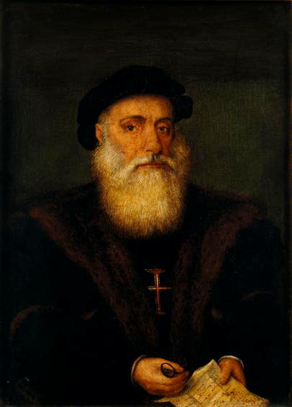
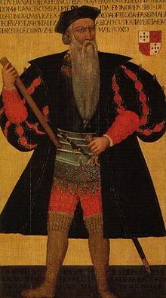
Age of Discoveries
Two of the most remarkable Portuguese navigators and military leaders were Vasco da Gama and Afonso de Albuquerque
Their military victories and conquests, as well as success in administering conquered lands, brought them fame and fortune.
Sadly, they were also responsible for their share of atrocities, perpetrated against civilians and/or prisoners

Slide 30
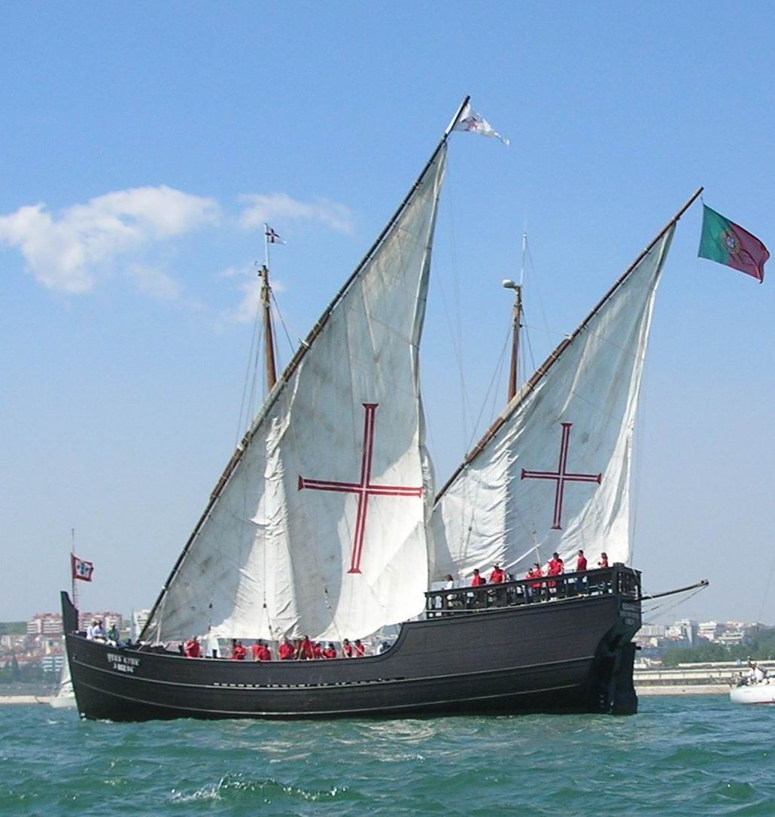
Portuguese caravel
This was the standard model used by the Portuguese in their voyages of exploration.
It was able to sail into the wind, unlike every other ship. It could accommodate about 20 sailors.

Slide 31
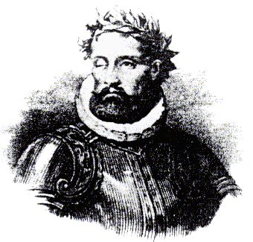
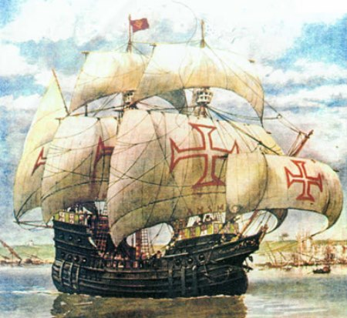
The Lusiads
An epic poem by Luis Vaz de Camoes, published about 1572.
The poem recounts the Portuguese voyages during the age of discoveries, including Vasco da Gama’s opening of the sea route to India and the Far East.

Slide 32
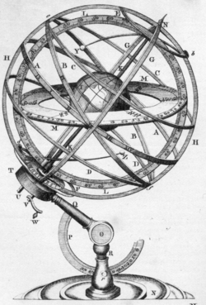
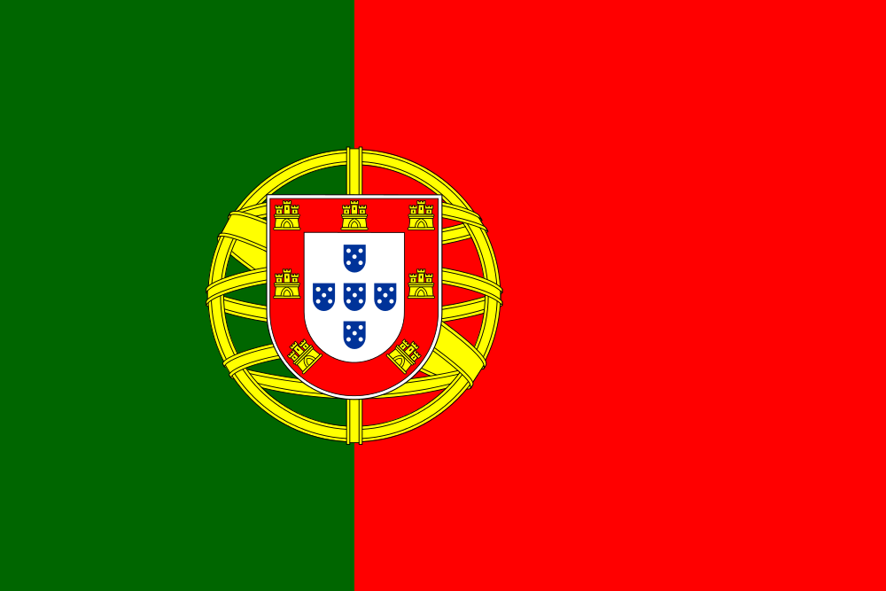
Portuguese navigation
The armillary sphere was introduced to Western Europe via Al-Andalus in the late 10th century, and is represented in the current Portuguese national flag

Slide 33
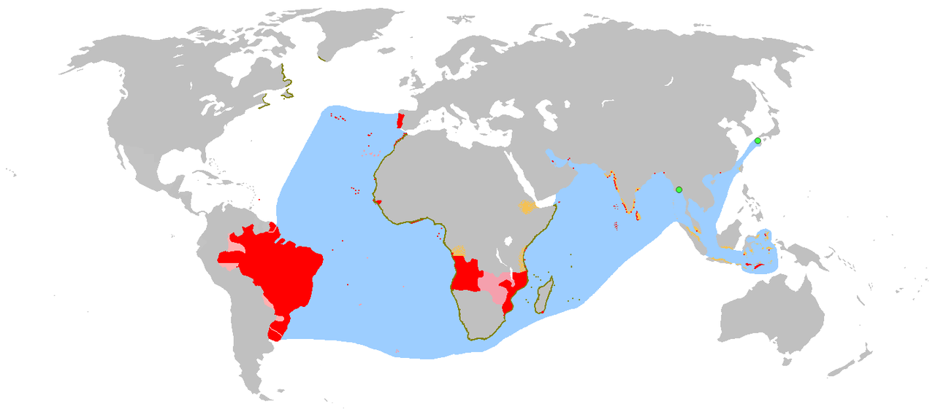
The Portuguese Empire (1415-1999)
Diachronic map, covering the period 1415-1999 AD
Red - actual possessions
Olive green – explorations
Orange - areas of influence and trade
Pink - claims of sovereignty
Light green - trading posts
Blue - main sea explorations, routes and areas of influence

Slide 34
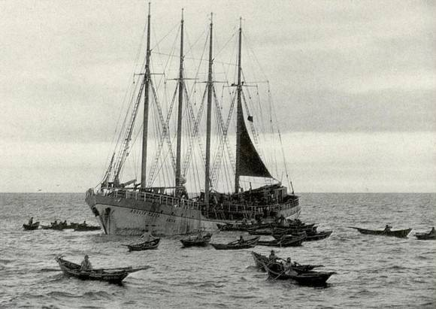
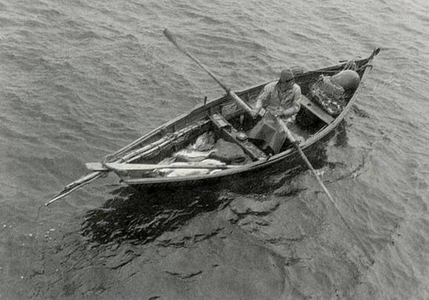
Codfish capture in Terra Nova
Portuguese sailing ships started fishing codfish in Terra Nova early in the XVI century
In 1550, 150 ships sailed from Aveiro, but in 1624 there were no ships in the Aveiro fleet
Traditional fishing was resumed in the XIX century and lasted until the 70’s of the XX century

Slide 35
Inquisition and the persecution of Jews
Jewish populations have existed in the territory even before the country was established
King Afonso I nominated Yahia Ben Yahi III the first Chief-Rabbi of Portugal
In 1492, Spain expelled its Jewish population as part of the Spanish Inquisition. Tens of thousands of Spanish Jews subsequently fled to Portugal, where King John II granted them asylum in return for payment. However, after only eight months, the Portuguese government decreed the enslavement of all Jews who had not yet left the country. In 1493, John II deported several hundred Jewish children to the newly discovered colony of São Tomé, where many of them died.
In 1497, under the pressure of the newly born Spanish State, the Church and also of part of the Christian people, Manuel I of Portugal decreed that all Jews had to convert to Christianity or leave the country without their children.
In 1506, around 2000 Portuguese Jews were massacred in Lisbon, followed by forced deportations to São Tomé, and establishment of the Portuguese Inquisition in 1536.

Slide 36
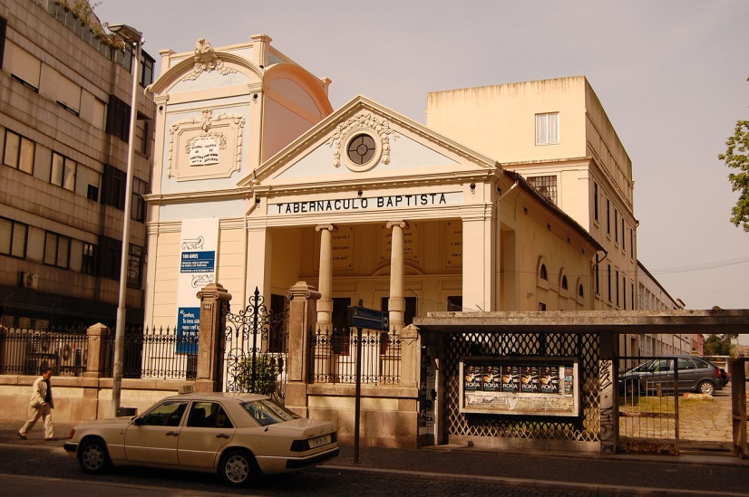
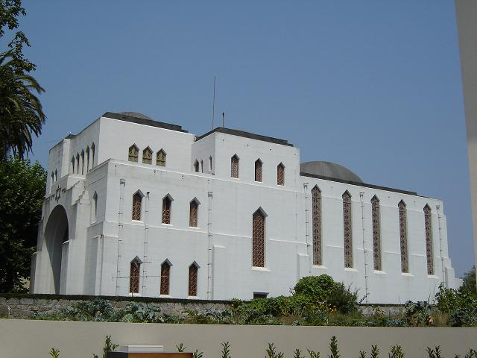
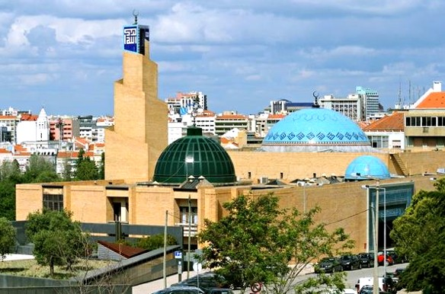
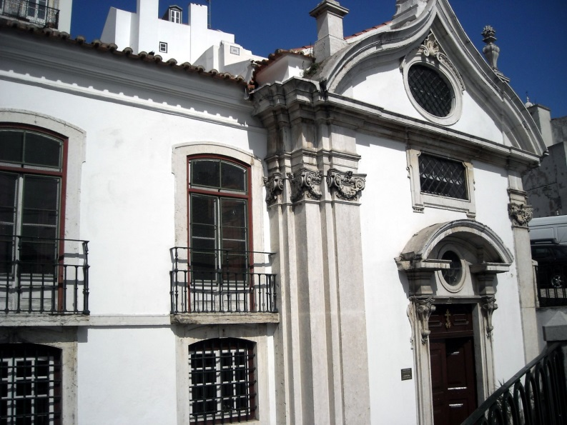
A quick jump in time to Religious cohabitation of today
Census 2011:
Catholic 81.00%
Orthodox 0.63%
Protestant 0.84%
Other Christian 1.82%
Jewish 0.03%
Muslim 0.23%
Other Non-Christian 0.32%
No religion 6.84%
No answer 8.29%
Porto’s Baptist
Tabernacle (top left)
Porto’s Sinagogue (top right)
Lisbon’s Mosque (left)
Lisbon’s Orthodox
Church (right)

Slide 37
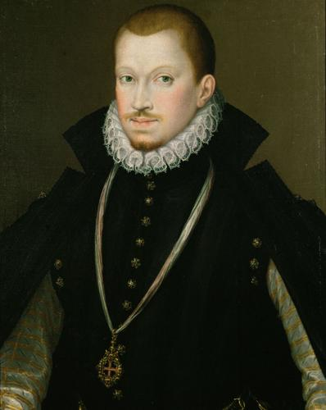
D. Sebastião and the succession crisis
In 1578, king Sebastian I is presumed dead in the battle of Alcacer-Quibir (Ksar El Kebir, Morocco), leaving no descendants; his great-uncle succeeds him but dies two years later with no clear heir appointed
The 1580 succession crisis led to Philip II of Spain to become king of Portugal, with the title Philip I of Portugal, on the condition that the kingdom and overseas territories remain separate from Spain, keeping their own laws and administrations
The perceived loss of sovereignty contributed to the legend that Sebastian was not dead and would return (“in a foggy morning”) to Portugal. This deeply rooted feeling, hope or desire, that Sebastian would return and solve all the problems became known as “Sebastianism”, an attitude still identifiable in present time Portugal.

Slide 38
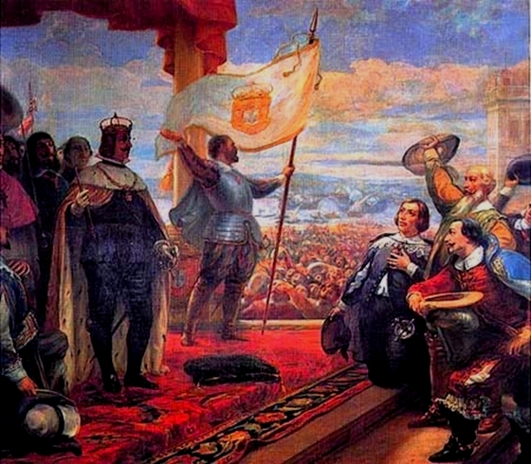
Restoration War, 1640-1668
The first 2 kings of the dynastic union ruling the Peninsula did so according to what had been previously agreed, but Philip III (IV in Spain) tried to centralize power in Madrid; growing dissatisfaction in Portugal led to the revolutionary coup d’état that took place in 1640, December 1st.
The result is the instauration of the 4th Portuguese Dynasty, the House of Bragança, and the acclamation of John IV as King of Portugal (image). By December 2, 1640, John had already sent a letter to the Municipal Chamber of Évora as sovereign of the country.
The ensuing Restoration War ended with the Treaty of Lisbon in 1668, whereby Spain recognized the Portuguese monarch. Portugal kept all overseas possessions except Ceuta, who never recognized the house of Bragança throughout the war.

Slide 39
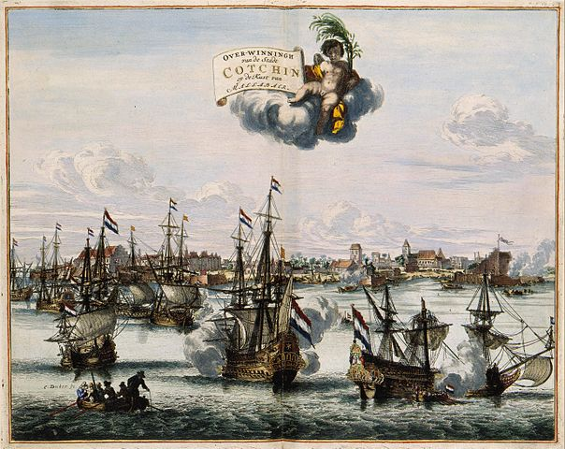
Decline of the overseas Empire
Early in the XVII century, under the “Iberian Union”, the Portuguese empire was under heavy pressure from the Dutch, both in Brasil and in the Far East (India and Oceania)
Many possessions were lost, but most were recovered after the Restoration, with British support
In 1662, Catarina de Bragança, daughter of John IV of Portugal, married Charles II of England, thus reinforcing the alliance; she’s credited for introducing the afternoon tea in England
Her dowry consisted of: 2 million gold pieces, Tangiers and… Bombay (Mumbay)
The capture of Kochi and victory of the Dutch over the Portuguese in 1663. Atlas van der Hem 1682

Slide 40
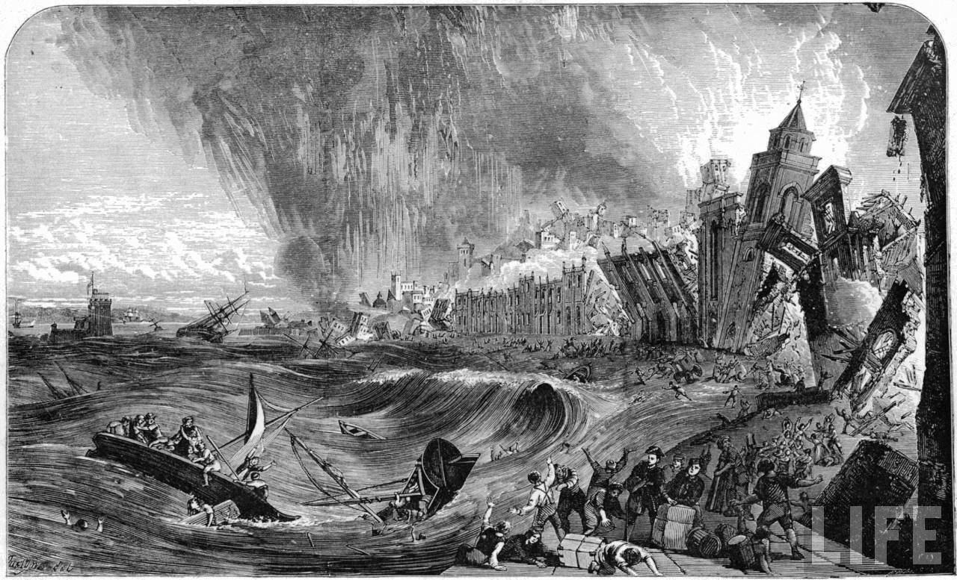
Lisbon’s Earthquake, 1755
At 9:40, hour of mass in All Saints Day, an eartquake of magnitude 8.5-9 hits Lisbon, follwed by a tsunami and uncontrolled fire across the city
Lisbon’s population in 1755: 275000
Casualties: 40 - 60000 dead
More than 85% of buildings destroyed
Massive reconstruction work, leading to Lisbon’s new “Pombaline” lower town
Profound effect in society, at diferent levels (Voltaire’s “Poème sur le désastre de Lisbonne”; Kant’s pioneer study in seismology; theological and philosophical implications,…)

Slide 41
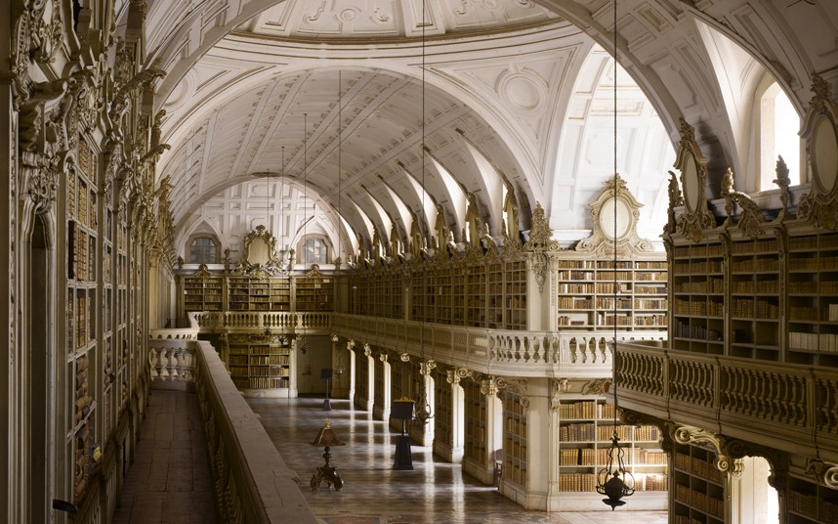
Mafra National Palace, built 1733-1755
A colony of ~500 bats is responsible for eating insects that could damage the books in the palace’s library (photo)

Slide 42
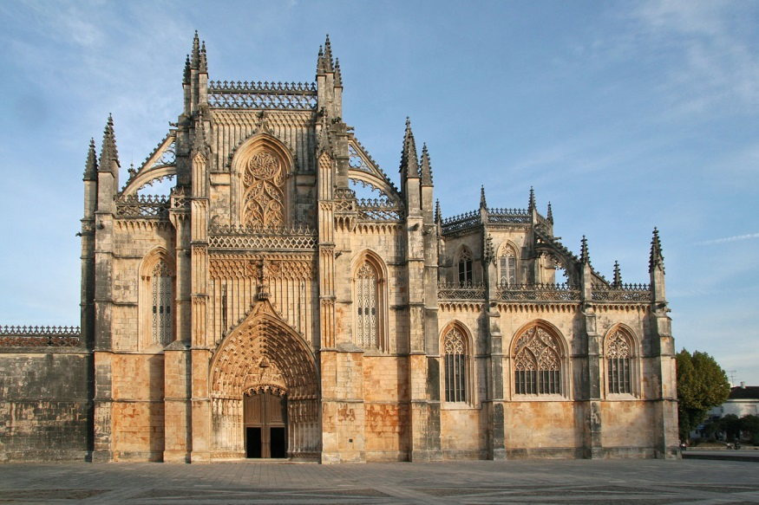
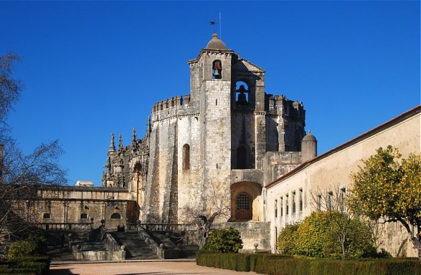
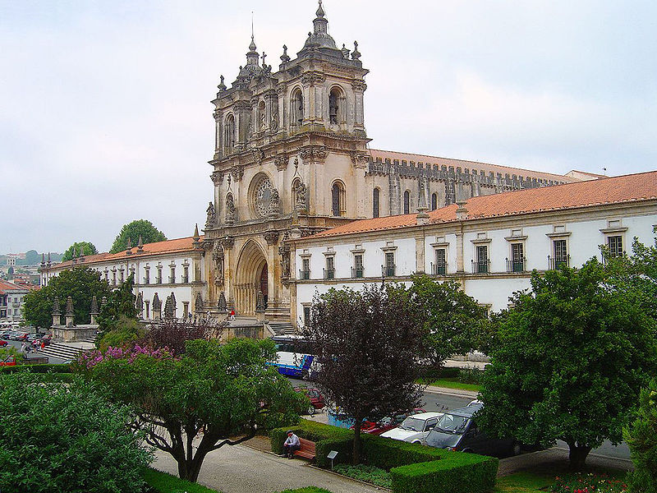

UNESCO’s World Heritage Monasteries and Convents in Portugal
Mosteiro da Batalha
Convento de Cristo, Tomar
Mosteiro de Alcobaça
Mosteiro dos Jerónimos, Lisboa

Slide 43

Alto-Douro Wine Region
The world's first wine region to have a formal demarcation (1756)
World Heritage Site since 2001

Slide 44

Napoleonic invasions
During the Napoleonic invasions of Portugal, the court was transfered to Brasil in 1808
After Napoleon’s defeat in 1815, the Prince Regent declines returning to Portugal, instead elevating Brasil from the status of a colony to that of a kingdom
The Prince, now King John VI, returns to Portugal after the Liberal Revolution of 1920

Slide 45
The Liberal Revolution, 1820 - Independence of Brasil - Liberal Wars
Revolutionaries’ demands: return of the King John VI, set up of a constitutional monarchy, revert Brasil to a colony
King’s heir Pedro, stayed in Brasil and was proclaimed Emperor after Brasil’s declaration of independence in 1822
In 1826, John VI dies with no clear heir, leading to 6 years of civil war, the “Liberal Wars” between liberals/constitutionalists and authoritarian absolutists, until the victory of the liberals

Slide 46

Whale catching in the Azores
Traditional harpooning of a sperm whale; last capture occurred in 1987

Slide 47

Abolition of capital punishment in Portugal
Portugal was one of the earliest abolitionist countries having removed the death penalty for political crimes in 1852, and for all civilian crimes on the 1st of July 1867.
The exception remained until 1976 for military acts of treason in the theatre of war, although the only executions, poorly documented, occurred in France during the great World War.
The last hangings took place on the 22nd of April 1846 in Lagos; the last execution of a woman dates from July 1772

Slide 48

The British Ultimatum, 1890
The 1890 British Ultimatum was an ultimatum by the British government delivered on 11 January 1890 to Portugal in breach of the Treaty of Windsor of 1386.
The ultimatum forced the retreat of Portuguese military forces from areas which had been claimed by Portugal on the basis of historical discovery and recent exploration, but which Britain claimed on the basis of effective occupation.

Slide 49

Last days of monarchy
In 1908, King Carlos I of Portugal and his heir-apparent, Prince Royal Luís Filipe were killed by assassins sympathetic to republican interests and aided by elements within the Portuguese Carbonaria, disenchanted politicians and anti-monarchists.
NRP D. Carlos I, oceanographic research vessel - named after king D. Carlos I, who was a patron of arts and sciences, and had a great personal interest in oceanography, having acquired the yacht Amelia for his own oceanographic expeditions

Slide 50

The First Republic
The Portuguese Republic was established after a coup d'état organized by the Portuguese Republican Party on 5 October 1910
The subjugation of the country to British colonial interests,
the royal family's expenses,
the power of the Church,
the political and social instability,
the system of alternating power of the two main political parties,
PM João Franco's dictatorship,
all factors contributed to an unrelenting erosion of the Portuguese monarchy

Slide 51


Livraria Lello & Irmão
History in books(tores)
Apart from the oldest operating bookstore in the world, the
established in 1732 in Lisboa,
Portugal houses one of the most
beautiful bookstores in the world, the
an impressive example of Art Nouveau architecture, built in 1906, in Porto (photo >>>)

Slide 52


Lello bookstore, built in 1906 (Porto)
Hemispherical interactive view of the Lello bookstore here (www.360portugal.com/Distritos.QTVR/Porto.VR/vilas.cidades/Porto/a5_lello.html)

Slide 53

Portugal in the Great War
In the beginning of the Great War (later, known as world War I), Portugal kept its neutrality. However, tensions between Germany and Portugal arose due to German U-boat warfare and clashes with German troops in the south of Portuguese Angola in 1914 and 1915.
Initially, both Portugal and Germany remained neutral, but there were many hostile engagements between the countries. Portugal wanted to comply with British requests and also protect its colonies in Africa, and ultimately tensions resulted in war between Portugal and Germany being declared, first by Germany.
The most traumatic incident during WWI for the Portuguese was the Battle of La Lys (April 1918), during which more than 7 thousand men lost their lives during a massive German offensive, backed with heavy artillery and lethal gas.
Anibal Milhais, the most decorated Portuguese soldier in the Great War, during the Battle of La Lys

Slide 54


S. Bento railway station, 1916, Porto
The inner walls are covered in azulejo panels, depicting both historical events and daily, ordinary life moments.
Azulejo panel depicting the Valdevez Battle, which assumed the form of a medieval jousting tournament, in 1140

Slide 55

Fernando Pessoa (1888-1935)
Portuguese poet, writer, literary critic, translator, publisher and philosopher, described as one of the most significant literary figures of the 20th century and one of the greatest poets in the Portuguese language. He also wrote in and translated from English and French.
"The feelings that hurt the most, the emotions that sting most, are those that are absurd: the longing for impossible things, precisely because they are impossible; nostalgia for what never was; the desire for what could have been; regret over not being someone else; dissatisfaction with the world’s existence. ”
- Fernando Pessoa, The Book of Disquiet

Slide 56


Majestic Café (est. 1921)
Another example of Art Nouveau architecture in Porto, Portugal
Virtual tour of the Majestic Café here
(www.cafemajestic.com/en/Majestic-Cafe/Photos-Videos/Virtual-Visit.aspx)

Slide 57
Estado Novo (“New State”)
In 1926, a coup d’état replaces the democratic, but unstable, First Republic by the National Dictatorship, an authoritarian regime
The rise to power of Salazar in 1932 marks the beginning of the “Estado Novo” (New State), a right wing, pro-Roman Catholic church, anti-decolonization, anti-Communism, authoritarian, “anti-democratic, anti-liberal and anti-parliamentarian” regime, overseen by a political police.
Still, Portugal joins the UN in 1955, and became a founding member of NATO, OECD and EFTA.

Slide 58

Portugal in World War II
Portugal’s support of Franco during the Spanish Civil War and the regime’s adopted fascist policies (political dictatorship, police state rule, bans on strikes, strident anti-Communism, and corporatist social and economic policies) gave the regime a fascist aura, although the status of neutrality was kept throughout the war, and Portugal maintained commercial relations with both Allied and Axis countries.
Allied sympathies were found among some of Salazar's supporters, opponents, and the politically indifferent.
Portugal had fought on the side of the Allies during the Great World War, and for Portuguese soldiers and their families the Germans were still considered the enemy.

Slide 59
Portugal in World War II (cont.)
In 1943, Winston Churchill surprised Members of Parliament when he said he would invoke a treaty dated from the 14th century (!) to request base facilities in the Azores; Portugal promptly responded favorably, and the base was used intensely by British and American troops.
With the turn of the war, around 1943, Portugal started to increasingly align its positions with the Allies, eventually stopping selling tungsten to Germany. Tungsten was the most strategically vital raw material Germany got from Portugal, as it was used in weapons and machinery manufacturing.
Portuguese neutrality was also important because it opened the way for many people to escape persecution. Several international relief organizations were active in Portugal. Portugal received about 100,000 refugees (Jewish and other European citizens fleeing the nazis), most of them ultimately leaving the country, mainly for the Americas. Even those refugees who were caught without papers were not sent back by Portugal.
Sources:
- Leite, Joaquim da Costa. "Neutrality by Agreement: Portugal and the British Alliance in World War II." American University International Law Review 14, no. 1 (1998): 185-199.
- Petropoulos, Jonathan. “Co-opting Nazi Germany: Neutrality in Europe During World War II.” Anti-Defamation League’s Holocaust Institute, 1-11
- Gayer, Gavin. “Political Neutrality in Europe during World War II”, California Polytechnic State Univ.

Slide 60

Portuguese Cinema Aniki-Bóbó (1942)
First feature-length movie directed by Manoel de Oliveira (born in 1908)
Directs his second feature film more than 20 years after the first, but since 1990 directs at least one feature-length movie per year
Currently filming “O Velho do Restelo” short movie, at the age of 105

Slide 61

End of the Portuguese State of India
In 1954, India occupies the territories of Dadra and Nagar Haveli
In 1961, India invades Diu, Damao and Goa, thus proceeding to the formal annexation of the remaining Portuguese territories in the Indian sub-continent.
Chapel of St. Xavier, Goa – World Heritage Site

Slide 62

Emigration
Socially significant emigration first occurred in the XV and XVI century during the discoveries.
Emigration on a massive scale began in the second half of the nineteenth century and continued into the 1980s. Between 1886 and 1966, Portugal lost an estimated 2.6 million people to emigration, more than any West European country except Ireland ⁽¹⁾.
The great flight occurred in the Sixties and its aim was Europe. Although the main reasons were economic, the weight of clandestine emigration was also heavy due to two main reasons : the attempt to escape the colonial war and ideological opposition to the political regime.
Today, large communities of Portuguese-born residents can be found in countries such as Germany (92000), Brazil (140000), Canada (150000), Spain (146000), USA (167000), France (580000), Luxembourg (42000), UK (84000), Switzerland (165000) and Venezuela (53000), among others ⁽²⁾.
Eric Solsten, ed. Portugal: A Country Study. Washington: GPO for the Library of Congress, 1993
Portugal’s Emigration Observatory (www.observatorioemigracao.secomunidades.pt/np4/2454.html)

Slide 63

Colonial War (1961-1974)
Portugal was engaged in slave trading since the 15th century, namely in Guiné and Angola
Even in 1961, colonial domination and exploration was outright disrespectful of human rights
In 1961, 1963 and 1964, liberation wars began respectively in Angola, Guiné and Moçambique
Massacres were perpetrated by both sides, and notably Wiriyamu (Moçambique), in 1972, was to become Portugal’s My Lai

Slide 64

Colonial War (1961-1974)
The war effort Portugal had to endure was almost impossible to maintain through the 70’s, representing 40% of the country’s annual budget in 1968.
An historic comparison, for easy reference and illustration:
Peak of US presence in Vietnam (1961-1974): ~536000 military in 1968
Peak of Portugal presence in the 3 African fronts (1961-1974): ~149000 military in 1973
Total US deaths in Vietnam: ~58000
Total Portuguese deaths in Africa: ~8300
Population of the US > 20x that of Portugal
Most importantly, the human and social cost of the war was very severe - families sent their young men to foreign countries, mothers prayed, songs were written about the soldiers never returning home…
Sources:
http://www.revistamilitar.pt/artigo.php?art_id=642
http://www.americanwarlibrary.com/vietnam/vwatl.htm
http://www2.iict.pt/?idc=102&idi=15621
http://www.veteranshour.com/vietnam_war_statistics.htm
http://www.guerracolonial.org/specific/guerra_colonial/uploaded/graficos/estatiscas/mortos.swf

Slide 65

The Carnation Revolution, 1974
The Carnation Revolution (25 de Abril), started as a military coup on 25 April 1974 which overthrew the regime of the Estado Novo.
The movement that started as a military coup organized by the Movimento das Forças Armadas (Armed Forces Movement, MFA), composed of military officers who opposed the regime, was soon coupled with an unanticipated and popular campaign of civil resistance.
Although mostly a “peaceful revolution”, 5 people were killed by agents of the political police, shooting from behind the windows at the crowd surrounding their headquarters.
This movement would lead to the fall of the “Estado Novo” regime, to the withdrawal of Portugal from its African colonies and East Timor, and to the instauration of a democratic regime in Portugal.

Slide 66

The end of the Colonial Era
East-Timor
Declared independence in 1975, following the Portuguese revolution, but was later invaded by Indonesia, whose government subjected the East-Timorese people to a brutal occupation for a quarter century.
In 1991, the massacre in the Santa Cruz cemetery, in Dili, in which indonesian military killed more than 270 peaceful demonstrators, became a turning point in the history of East-Timor, drawing massive international attention to the situation in the occupied country.
International pressure led to a UN-backup referendum in 1999, which resulted in an overwhelming majority in favor of independence, and eventually forced Indonesia to end the violent occupation.
East Timor became the first
new sovereign state of the
21st century on May 20, 2002.
Photogram of film footage of the Santa Cruz massacre, made by Max Stahl, who risked his own life to film the massacre and bury the footage cassette in a freshly dug grave before he was arrested by the military.

Slide 67



The end of the Colonial Era
Macau
After long, peaceful negotiations, Portugal returns Macau to China in 1999, thus effectively putting an end to the Portuguese Empire.
But church ruins is not all that the Portuguese left behind - the Macau Grand Prix is a motor-racing event held annually in Macau for the last 60 years.
Since 1983, the F3 Macau GP has raised its reputation in the motorsport world by attracting the best young drivers from Europe and Japan to compete in the event.
Ruins of St. Paul’s Church, in Macau,
World Heritage Site since 2005)

Slide 68

Present day
Since 1999, the only overseas territories that are a part of Portugal are the 2 Atlantic Archipelagos: Madeira and Azores
Both uninhabited at the time of their discoveries, they are now autonomous regions.

Slide 69




Azores

Slide 70




Madeira

Slide 71

Planning to expand…
Expansion of Portugal’s maritime domains (EEZ + extended continental shelf zone), submitted to UN’s Commission on the Limits of the Continental Shelf

Slide 72


Álvaro Siza (born 1933)
Portuguese Architecture, home and abroad…
1992 Pritzker Architecture Prize
(Right photo, “Bonjour Tristesse” building, in Berlin, by Álvaro Siza)
Souto de Moura (born 1952)
2011 Pritzker Architecture Prize
(Left photo, Paula Rego’s Museum, in Cascais, by Souto de Moura)

Slide 73

Portuguese Literature José Saramago (1922-2010)
In 1992, the Government of Portugal ordered the removal of ”The Gospel According to Jesus Christ” from the Aristeion Prize's shortlist, claiming the work was religiously offensive.
Disheartened by this political censorship of his work, Saramago went into exile on the Spanish island of Lanzarote, upon which he resided until his death in 2010.
1998 Nobel Prize in literature

Slide 74




“…even McDonalds has class, in Porto” (quote from a travel blog)
Former Imperial Café, turned McDonalds restaurant, but where one can still find “pasteis de nata”, the portuguese custard tart.

Slide 75
A problem has been detected and Windows has been shut down to prevent damage
to your computer.
The problem seems to be caused by the following file: SPCMDCON.SYS
PAGE_FAULT_IN_NONPAGED_AREA
If this is the first time you've seen this stop error screen,
restart your computer. If this screen appears again, follow
these steps:
Check to make sure any new hardware or software is properly installed.
If this is a new installation, ask your hardware or software manufacturer
for any Windows updates you might need.
If problems continue, disable or remove any newly installed hardware
or software. Disable BIOS memory options such as caching or shadowing.
If you need to use Safe Mode to remove or disable components, restart
your computer, press F8 to select Advanced Startup Options, and then
select Safe Mode.
Technical information:
*** STOP: 0x00000050 (0xFD3094C2,0x00000001,0xFBFE7617,0x0000 0000)
*** SPCMDCON.SYS - Address FBFE7617 base at FBFE5000, DateStamp 3d6dd67c

Slide 76

KEEP CALM AND
CARRY ON

Slide 77

This week in the news…
Portugal said on Sunday it would exit its three-year 78-billion-euro bailout this month without a precautionary credit line, as the country returns to growth after years of painful austerity and unpopular reforms (Reuters)

Slide 78
to be continued…

Slide 79
… bonus tracks…
Portugal – The beauty of simplicity (http://vimeo.com/33294024 or www.youtube.com/watch?v=j5tFXbhEm1I)
Look Up at the Stars, Portugal! (http://vimeo.com/17375004)
Portugal Tourism promo (www.youtube.com/watch?v=5tLMZ0WTxvc)
World Heritage Portugal (www.youtube.com/watch?v=qt-T6Zbry98)
5 Things You’ll Love & Hate about Portugal (www.youtube.com/watch?v=hcOTxkFRWrI)
History of Portugal in 7 Minutes! (www.youtube.com/watch?v=mQoAE1emWDE)
…and more… www.visitportugal.com/en/sobre-portugal/videos

